Slide 1


Stock Market Forecasting Using Deep Learning with long short-term memory and gated recurrent unit
Team Members:
Akash Badhautiya
1
Roll Number: 24AI60R43
2
Sai Teja Chunchu
Roll Number: 24AI60R37
3
Abhishek Biswas
Roll Number: 24AI60R40

Slide 2

Introduction to the Problem
1
Predicting time series data
Is a popular research area due to new technologies and
methods.
2
Stock market data
Is very complex and influenced by unpredictable factors.
3
Deep learning, particularly GRU and LSTM,
offers improved accuracy in predicting stock prices.
4
Historical stock data (OHLC) and Technical indicators,
are used in this study for forecasting open price of various
stocks

Slide 3

Motivation
Forecasting using time series data is crucial in various fields, including weather forecasting and stock market predictions.
Stock market prediction is complex due to uncertainty and market volatility
Improved models are needed to assist investors in making informed decisions.
Deep learning techniques, such as GRU and LSTM, can better capture long-term dependencies in time series data.
The study aims to improve prediction accuracy by comparing proposed models with existing approaches.

Slide 4

Literature Review Overview

Slide 5

Stock Forecasting Techniques
1
Time Series Analysis
Uses past data to predict future events.
2
Fundamental Analysis
Focuses on financial data for long-term predictions.
3
Technical Analysis
Analyzes past price movements for short-term forecasts.

Slide 6
Deep Learning in Stock Prediction
Deep Learning Networks (DLNs)
Deep Neural Networks (DNNs)
Maps complex, nonlinear data relationships.
Discover correlations in data and forecast stock values.
Suitable for erratic stock market data.

Slide 7
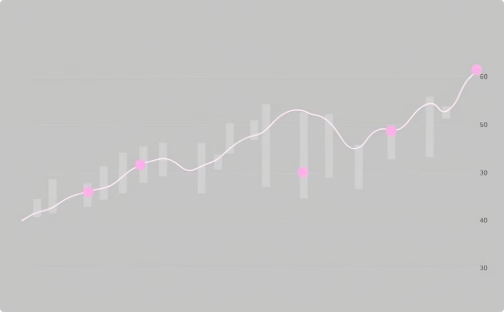

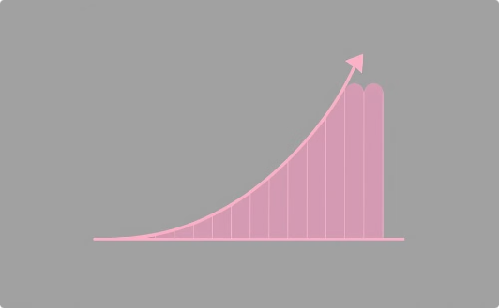
Challenges in Stock Prediction
Data Collection
Vanishing Gradients
Exploding Gradients
Data availability is limited due to privacy concerns.
Reduces gradients to zero, limiting learning.
Causes extremely large gradients, leading to poor learning.

Slide 8

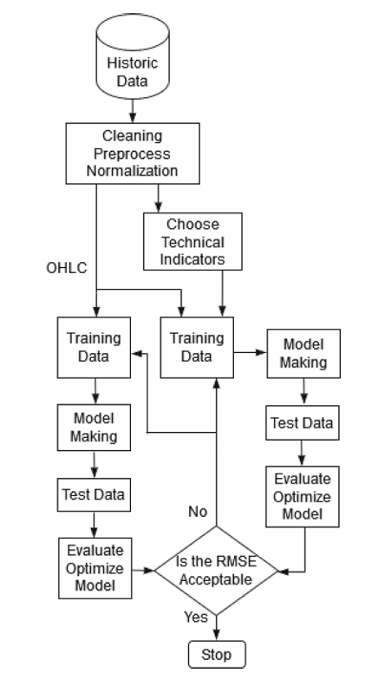


Methodology
Recurrent Neural Networks (RNNs)
Long Short-Term Memory (LSTM)
Gated Recurrent Unit (GRU)
Model and Training
Two stage inputs
Cleaning, Preprocessing and Normalization
Different performance metrics
Hyperparameters

Slide 9

Recurrent Neural Networks
Recurrent Neural Networks (RNNs) are neural networks designed to process
sequential data by using loops to maintain information across time steps.

Slide 10
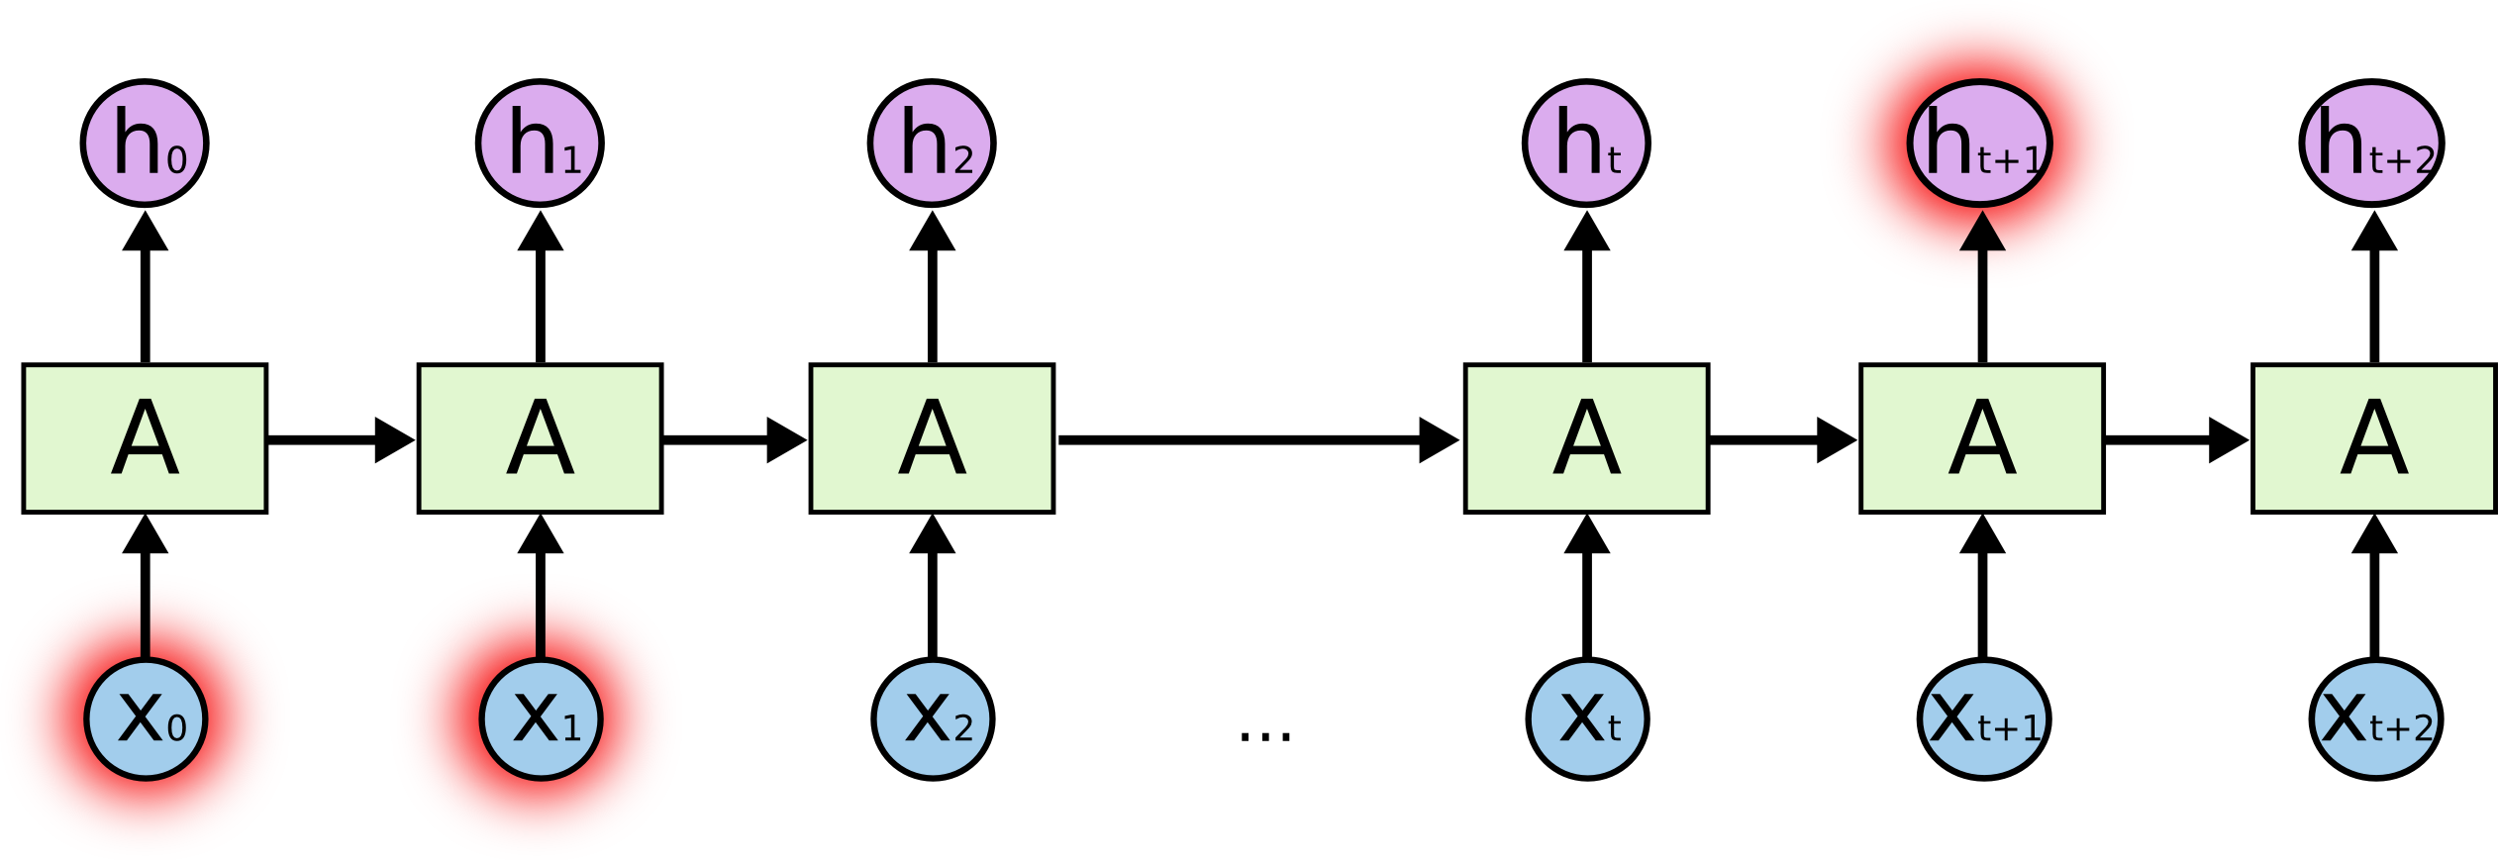
The Problem of Long-Term Dependencies
Akash eats samosa almost everyday, it shouldn’t be hard to guess that his favourite cousine is Indian. But Abhishek however is a lover of pastas and cheese that means his favourite cousine is Italian.

Slide 11


Long Short-Term Memory (LSTM)
Core Ideas
Cell State (C)
Gates
Forget Gate (f)
Input Gate (i)
Output Gate (o)

Slide 12




Long Short-Term Memory (LSTM)

Slide 13

Gated Recurrent Unit (GRU)
Core Ideas
No separate cell state
Gates
Reset Gate (r)
Update Gate (u)
GRU is computationally more efficient compared to LSTM

Slide 14
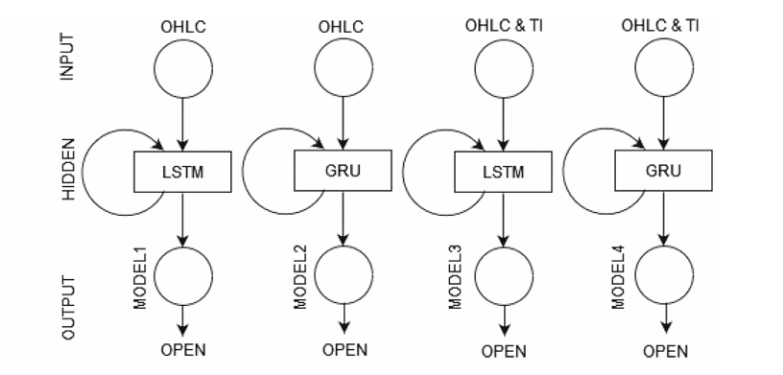
Model Output
Open price of the following day
Stage-1 Input (OHLC)
Open price
High price
Low price
Close price

Slide 15

Stage-2 Extra Inputs
Simple Moving Average $\left(SMA\right)=\frac{O_{1}+O_{2}+⋯+O_{n}}{n}$
Exponential Moving Average $\left(EMA_{t}\right)=k×Open\left[t\right]+\left(1−k\right)×EMA$
Relative Strength Index $\left(RSI\right)=100−\frac{100}{1+\frac{avg up}{avg down}}$
Moving Average Convergence Divergence $\left(MACD\right)=EMA_{12 day}−EM$
Average Directional Index ($ADX_{t})=\frac{(priorADX×13)+DX_{t}}{14} 1st ADX=\frac{1}{14}\sum_{t=1}^{14}{ }DX_{t}$

Slide 16
Model Details
Optimizer: Adam Hidden Layers: 2
Neurons per layer: 50
Normalization: Min-max
Batch Size: 50
Epochs: 100
Learning Rate: 0.001
Different Performance Metrics
Mean Absolute Percentage Error (MAPE)
Mean Absolute Error (MEA)
Mean Directional Accuracy (MDA)
Root Mean Squared Error (RMSE)
R2

Slide 17
Results and Comparisons

Slide 18

Datasets
1
Intel Corporation (INTC)
Data from January 2011 to September 2022.
2
Indian Oil Corporation Limited (IOC.NS)
Data from January 2011 to September 2022.
3
NTPC Limited (NTPC.NS)
Data from January 2011 to September 2022.
4
Citigroup Inc. (C)
Data from January 2011 to September 2022.

Slide 19

Datasets (contd.)
5
GF Securities (sz.000776)
from the Shenzhen Stock Exchange
6
Google Class C (GOOGL)
Data from January 1, 2014, to January 30, 2020.
7
Infosys (INFY)
Data from January 1, 2015, to January 31, 2020.
8
Apple Inc. (AAPL)
Data from 2010 to 2021.
Each dataset included OHLC (Open, High, Low, Close) stock price values, and some experiments included additional technical indicators like SMA, EMA, RSI, MACD, and ADX.

Slide 20
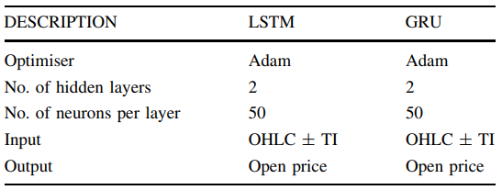
Results
Metrics Evaluation: MSE, MAE, MAPE, R² used.
Results Display: Tables and graphs to compare model performance.
Table 1 - Model details

Slide 21
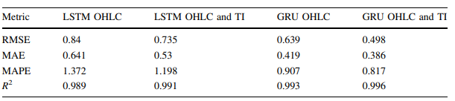
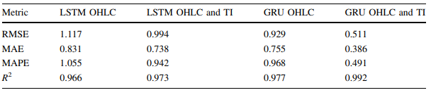
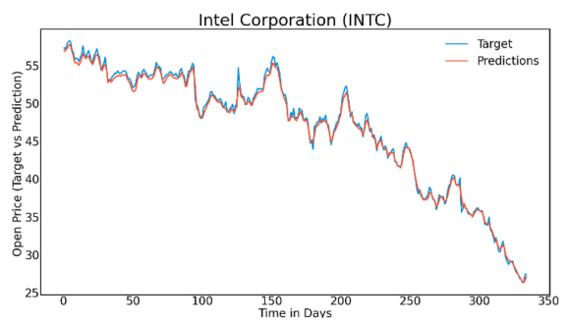
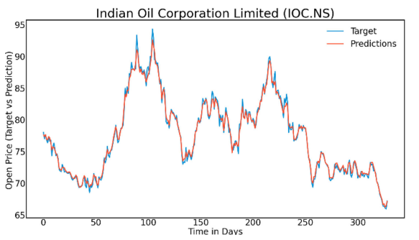
Results (contd.)
Table 2 - Performance of Proposed Models on INTC Data
Table 3 - Performance of Proposed Models on IOC.NS Data
Fig. 4 Input OHLC and TI, INTC—GRU
Fig. 5 Input OHLC and TI, IOC.NS—GRU

Slide 22
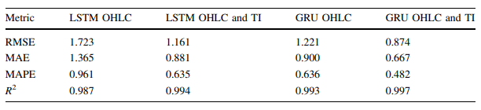
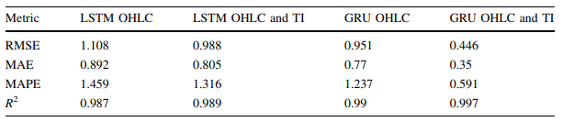
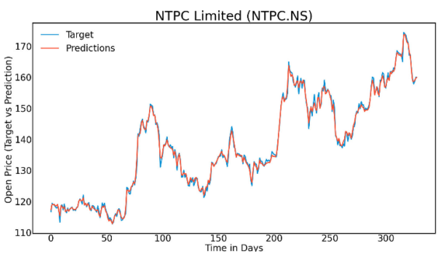
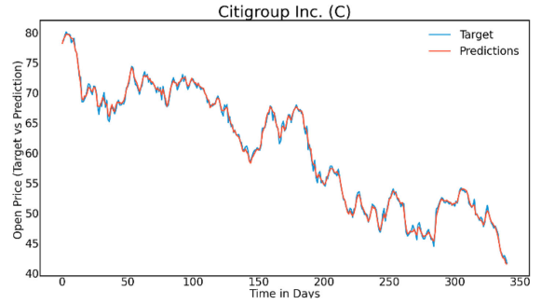
Results (contd.)
Table 4 - Performance of Proposed Models on NTPC.NS Data
Table 5 - Performance of Proposed Models on Citigroup Inc. Data
Fig. 6 Input OHLC and TI, NTPC.NS—GRU
Fig. 7 Input OHLC and TI, Citigroup Inc. (C)—GRU

Slide 23
Results(contd.)
Accurate Predictions
Proposed GRU and LSTM models accurately predicted stock opening prices.
GRU Outperforms LSTM
GRU models achieved lower error metrics compared to LSTM models.
Enhanced Performance
Including technical indicators enhanced overall model performance.

Slide 24
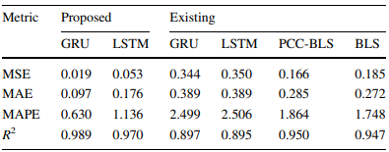
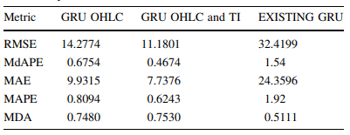
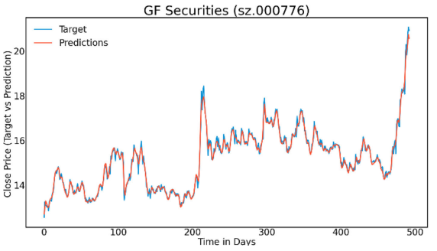
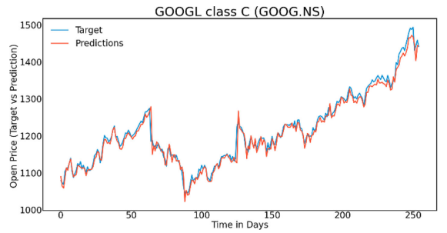
Comparisons
Table 6 - Comparison of Proposed and
Existing Models (SZ.000776)
Table 7 - GOOGL Stock Prediction Using
GRU Models
Fig. 8 Input OHLC, GOOGL—GRU
Fig. 11 Input OHLC and TI, GOOGL—GRU

Slide 25
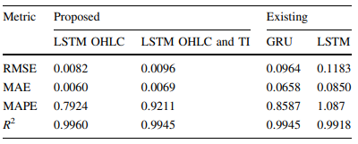
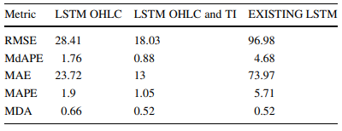
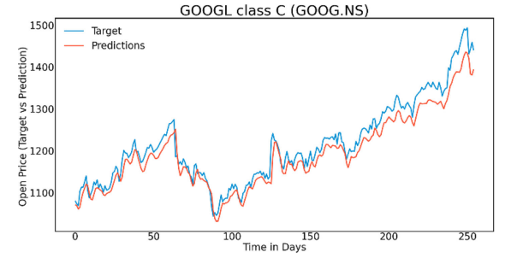
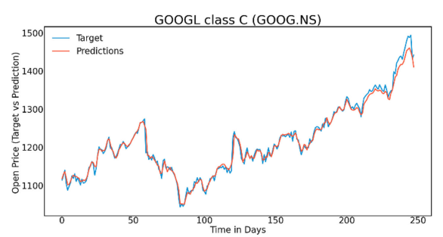
Comparisons(contd.)
Table 8 - Comparison of Proposed and
Existing LSTM Models (GOOGL)
Table 9 - Comparison of the proposed
and existing models
Fig. 13 Input OHLC, GOOGL, LSTM
Fig. 14 Input OHLC and TI, GOOGL—LSTM

Slide 26
Comparisons(contd.)
Superior Performance
GRU Consistency
Combined Data Advantage
Proposed models significantly outperformed existing prediction models.
GRU networks consistently showed better accuracy than LSTM networks.
Models using both OHLC data and technical indicators demonstrated superior results.

Slide 27

Conclusions
Effective Prediction
Technical Indicator Importance
Significant Improvements
GRU and LSTM models effectively predict stock prices, with GRU being more accurate.
Technical indicators play a crucial role in improving prediction accuracy.
The proposed models offer substantial improvements over existing methods.

Slide 28

Future Work
1
Indicator Expansion
Incorporate more financial indicators to refine model predictions.
2
Parameter Optimization
Further fine-tune neural network parameters for optimization.
3
Automated Indicator Selection
Develop automated methods for selecting relevant technical indicators.

Slide 29
Reference
Sivadasan, E. T., Sundaram, N. M., & Santhosh, R. (2024). Stock market forecasting using deep learning with long short-term memory and gated recurrent unit. Soft Computing, 28(7), 1-16. https://doi.org/10.1007/s00500-023-09606-7
https://colah.github.io/posts/2015-08-Understanding-LSTMs/
https://www.youtube.com/watch?v=tOuXgORsXJ4&list=PLeo1K3hjS3uu7CxAacxVndI4bE_o3BDtO

